Slide 1
New York Education System
By: Elijah Fuller

Slide 2
The DataSet
The dataset can be found on Kaggle https://www.kaggle.com/passnyc/data-science-for-good#2016%20School%20Explorer.csv and was provided by PASSNYC.
The dataset included 1272 schools in the New York City area.
The test scores are from a test called SHSAT
The school dataset provider's definition for rigorous instruction is how well the students were engaged during the curriculum.

Slide 3
More About the Dataset
The shape is 1272 rows (schools) and 161 columns
The dataset intended use is to assist the school system discriminate between which schools needed the most help
There were 3 features that had nearly no data in the columns
Adjusted Grade – 1270/1272
New? – 1243/1272
Other Location in LCGMS – 1271/1272

Slide 4
What is the SHSAT? Specialized high School Admissions Test
8 New York specialized schools require this test for entrance
This test is given to students in the eighth and ninth grades
The test assesses English and math skills of the student
Students are ranked based on their test scores and assigned to a school based on ranking.

Slide 5
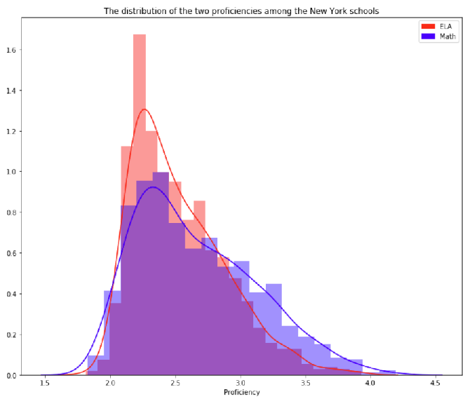
ELA vs Math Proficiency

Slide 6
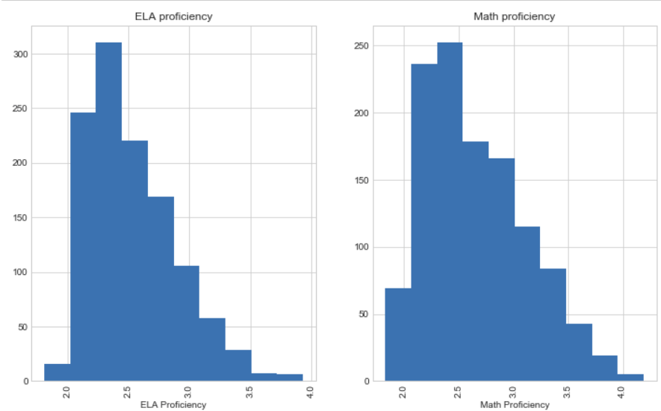
Full counts of both proficiencies

Slide 7
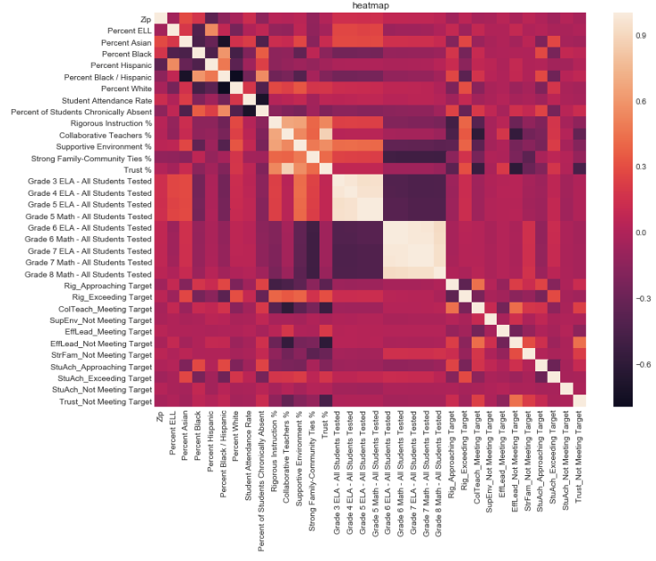
HeatMap to show correlation between features

Slide 8
My Feature selection Process
Dropped irrelevant features to lower the number of features to 56 from 161
Tried out two forms of feature selection: PCA and manually removal
Dropped poor performers based on Random Forest feature importance to 34

Slide 9
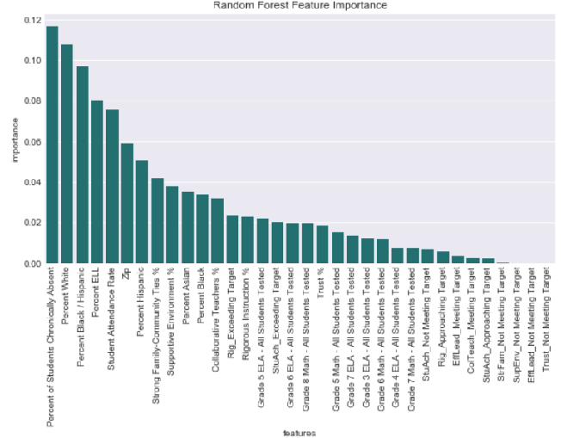
Features Ranked in Importance for Math

Slide 10
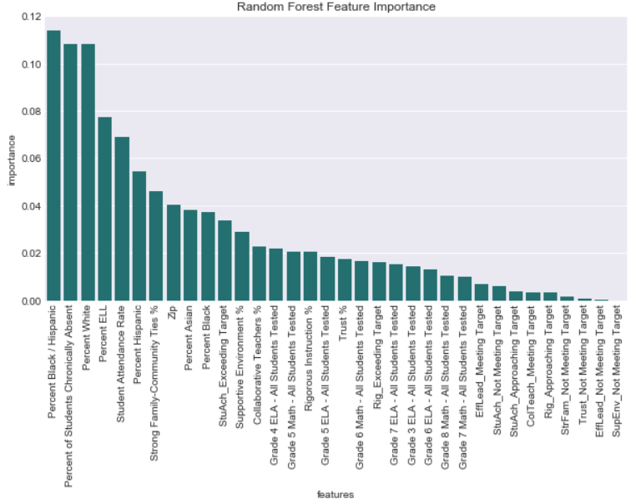
Features Ranked in Importance for ELA

Slide 11
PCA Principal Component Analysis
Reduces the complexity by reducing the number of variables to a smaller set of components
Reduces the dimensionality
Extracts information while removing the noise
Simplifies the dataset
PCA uses Euclidean distance

Slide 12
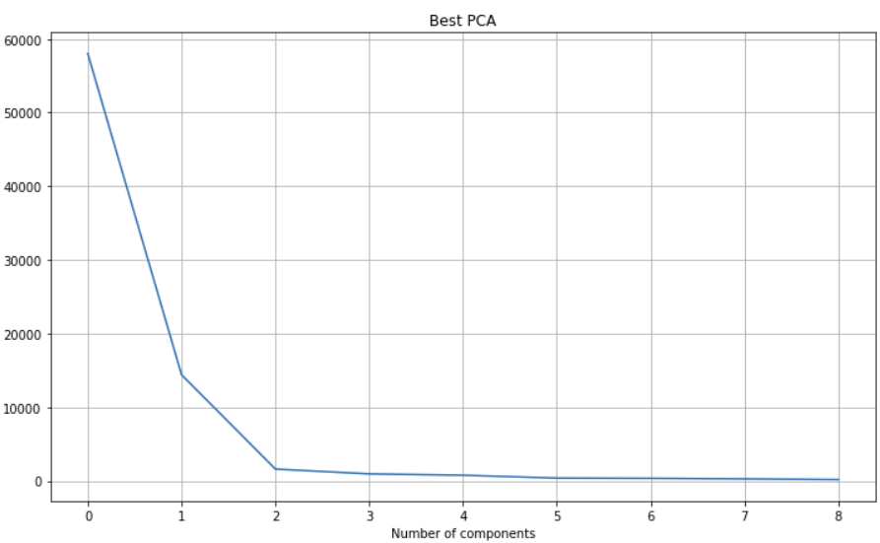
PCA Feature selection

Slide 13
Model Tuning
All models were tuned using gridsearchCV
I used both PCA and my manually adjusted feature set for each model
I tuned the models individually for feature set against ELA and math proficiency
I also used cross_val_score to split the data into 5 groups to test for overfitting

Slide 14
KNN
KNN is a simple algorithm that stores all datapoints and classifies the new datapoints based on the similarity to the previous points.
KNN has a relatively high accuracy while being extremely simple
KNN can be used for classification or regression
Using KNN can be computationally difficult due to storing the entire training data set
Sensitive to irrelevant features and the scale of data

Slide 15
KNN
My best parameters for Math was n_neighbors = 212, weights ='distance’ using my manual feature set.
Average accuracy was 73% and overfitting was minimal at +/- .3%
PCA feature had just a slightly lower accuracy at 72.8
My best parameters for ELA was n_neighbors = n_neighbors = 30, weights ='distance' using my manual feature set.
I found ELA had much better accuracy 88.62% accuracy with overfitting +/-2%
PCA feature set performed slightly lower at 87% with .1% overfitting

Slide 16
Logistic Regression
Logistic Regression is a classification algorithm that is designed to find the relationship between features and probability of particular outcome
Simple and efficient
Low variance
Does not work well with larger number s of categorical features

Slide 17
Logistic Regression
My best parameters for Math was C= 1.7000000000000006 using my manual feature set.
Average accuracy was 84% and overfitting was much higher at +/- 8%
PCA feature had had a much lower accuracy at 72.8 but with only .5% overfit
My best parameters for ELA was C = 0.002 using my manual feature set.
I found ELA had much better accuracy 91.4% accuracy with overfitting +/-3%
PCA feature set performed slightly lower at 72.8% with .4% overfitting

Slide 18
Ridge regression
Ridge regression shrinks the coefficients so the variables with minor contributions have coefficients close to zero
Reduces the model complexity by coefficient shrinkage called ridge estimator
Uses the L2 regularization technique
By reducing the coefficient of features with little relevance, it minimizes those feature’s impact on the trained model

Slide 19
Ridge Regression scores
My best parameters for Math was C= 0.019000000000000003 using my manual features.
Average accuracy was 84.67% and overfitting was similar higher at +/- 8%
PCA feature had had a much lower accuracy at 72.8 but with only +/-.5% overfit
My best parameters for ELA was C= 0.089999999999999927 using my manual feature.
I found ELA had much better accuracy 90.76% accuracy with overfitting +/-3%
PCA feature set performed slightly lower at 72.8% with +/-4% overfitting

Slide 20
Lasso Regression (Least absolute shrinkage and selection operator)
Lasso regression is similar to ridge regression, however it reduces the coefficient to 0
Setting the coefficients to 0 will remove the unwanted features
Can be used to prevent overfitting
Lasso works by fitting a model while excluding one of the features if the fit is still good enough that feature gets excluded, it continues to cycle through all features

Slide 21
LASSO Scores
My best parameters for Math was C= 3.8700000000000028 using my manual features.
Average accuracy was 84.6% and overfitting was similar higher at +/- 7%
PCA feature had had a much lower accuracy at 72.8 but with only +/-.3% overfit
My best parameters for ELA was C= 6.3199999999999967 using my manual feature.
I found ELA had much better accuracy 90.6% accuracy with overfitting +/-3%
PCA feature set performed slightly lower at 72.8% with +/-3% overfitting

Slide 22
SVC Support Vector Cluster
SVC is a supervised machine learning algorithm outputs an optimal hyperplane to categorizes new examples.
SVM uses the dot product to find the optimal hyperplane and then finds the best-fit boundaries with the hyperplane, this is called the kernel trick
SVM is resistant to over fitting
Can work with infinite-dimensional feature space

Slide 23
SVC Scores
My best parameters for Math was kernel= 'rbf', max_iter =130 using my manual features.
Average accuracy was bad at 62.4% and overfitting was similar higher at +/- 15%
PCA feature had had a much lower accuracy at 72.8 but with only +/-.3% overfit
My best parameters for ELA was kernel= 'rbf', max_iter =106 using my manual feature.
I found ELA model performed better at 87.2% accuracy with overfitting +/- 2.5 %
PCA feature set performed lower at 85.52% with +/- 3% overfitting

Slide 24
Random Forest
Random Forest is a supervised learning algorithm that is an ensemble of decision trees
Random forest often uses the “bagging” method
Random forest can also be used for classification and regression problems
Random forest can build from hundreds, even thousands of trees and merge them into an accurate and stable prediction
Runs in parallel and outputs are aggregated
Random forest can become slow and inefficient if the model has a large number of trees
Random forest is referred to a “black box” model as the output gives little insight to how the model got its conclusion.

Slide 25
Random forest scores
My best parameters for Math criterion= 'entropy', max_depth= 38, n_estimators= 34, max_features = 'sqrt' using my manual features.
Average accuracy was 85.22% and overfitting was at +/- 6%
My best parameters for ELA was kernel= 'rbf', max_iter =106 using my manual feature.
I found ELA model performed better at 92% accuracy with overfitting +/-3 %

Slide 26
Gradient Boosting
Gradient boosting is a supervised learning algorithm often uses decision trees and will perform a multitude of times while adjusting the model based on what was learned.
Builds one tree at a tree rather than in parallel
Is commonly a great performer, even when compared with random forest
The training is slow compared to some of the other supervised models
Is prone to overfitting

Slide 27
Gradient boosting score
My best parameters for Math was max_depth= 3, n_estimators= 31, max_features = 'log2’ using my manual features.
Average accuracy was 85.03% and overfitting was at =/- 7%
PCA feature had had a much lower accuracy with +/- 4% overfitting
My best parameters for ELA was max_depth= 3, n_estimators=37, max_features = 'log2' using my manual feature.
I found ELA model performed really well at 93.2% accuracy with overfitting +/-2.5%
PCA feature set performed lower at 75% with +/- 3% overfitting

Slide 28
Best Results
MODEL | Math Accuracy | Math Overfit | ELA Accuracy | Math Overfit
Random Forest | 85.22% | +/-6% | 92% | +/-3 %
logistic regression | 84% | +/-8% | 91.4% | +/-3%
Ridge regression | 84.67% | +/- 8% | 90.76% | +/-3%
Lasso regression | 84.6% | +/- 7% | 90.6% | +/-3
SVC | 62.4% | +/-15% | 87.2% | +/- 2.5 %
Gradient Boosting | 85.03 | +/- 7% | 93.2% | +/-2.5%
KNN | 73% | +/-.3% | 88.62% | +/-2%

Slide 29
Conclusion
I had several key takeaways from this project:
The only bad performer came from SVC, the rest of the models did pretty well
I was impressed by how close the simpler models came close the more complex models
PCA did not impress me this project, I left in my PCA results to remind me that I need to test alternatives also
Random Forest performed the best but not by a lot
The other simpler models could be used to reduce complexity if needed.

